Slide 1
Secure Coding practices
Day 2

Slide 2
Agenda
Overview of Software Vulnerabilities
Secure Coding Best Practices
Secure SDLC
Secure Coding in .net

Slide 3
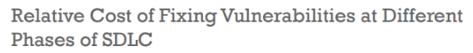
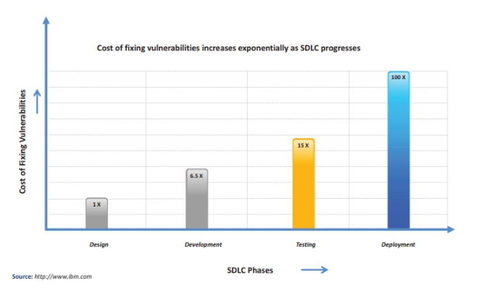

Slide 4
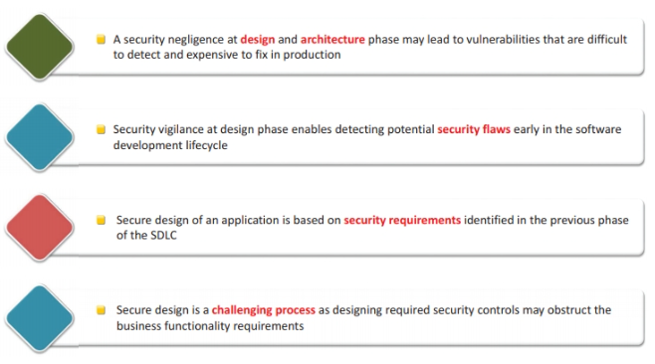

Slide 5
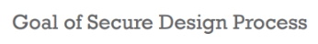
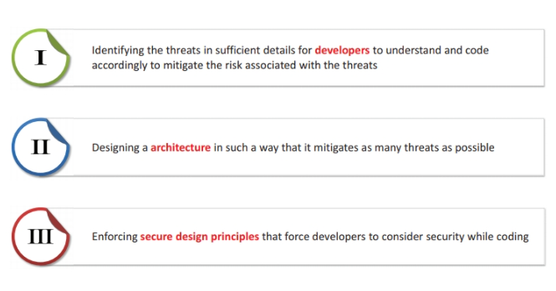

Slide 6
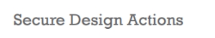
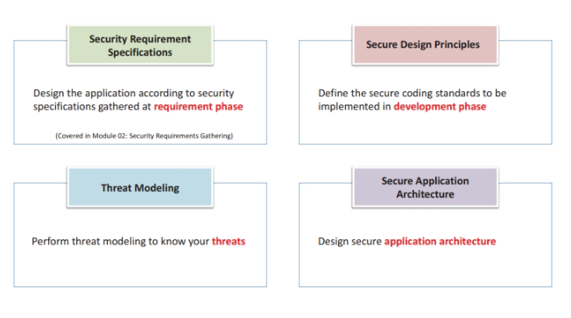

Slide 7
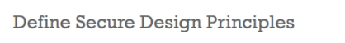
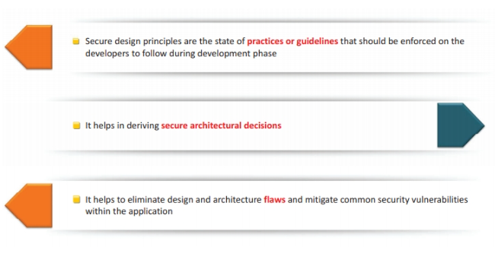

Slide 8
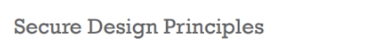
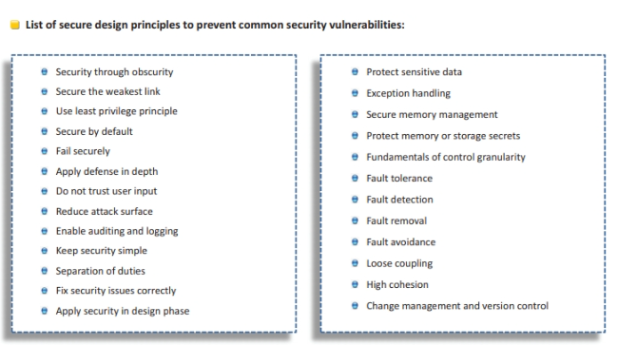

Slide 9
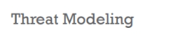
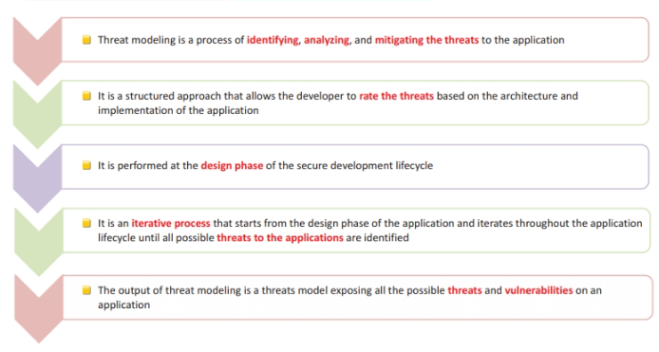

Slide 10
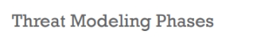
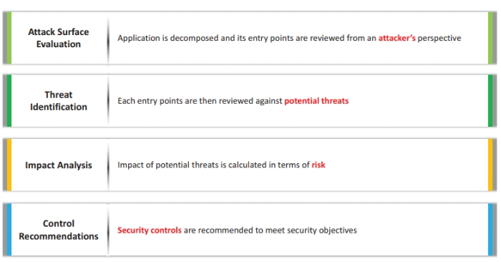

Slide 11
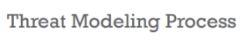
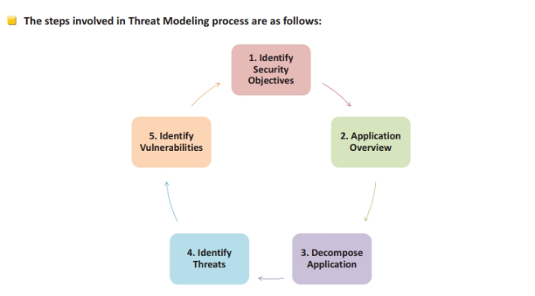

Slide 12
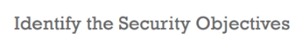
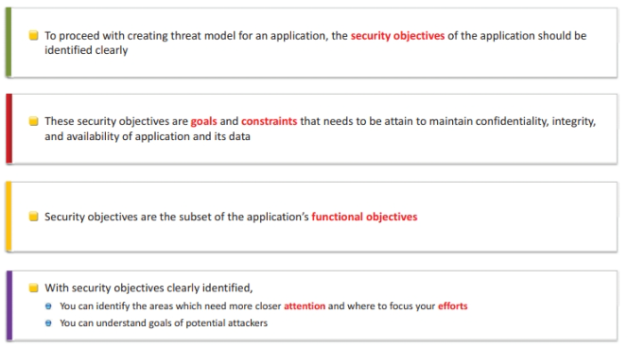

Slide 13
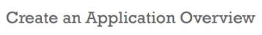
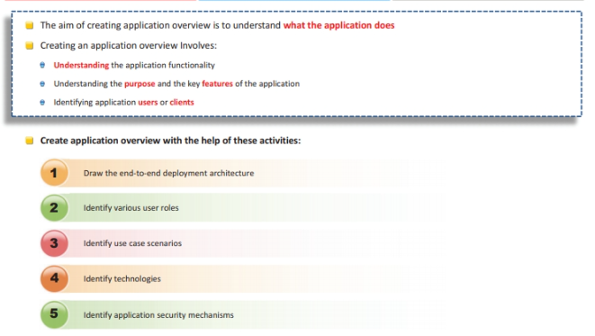

Slide 14
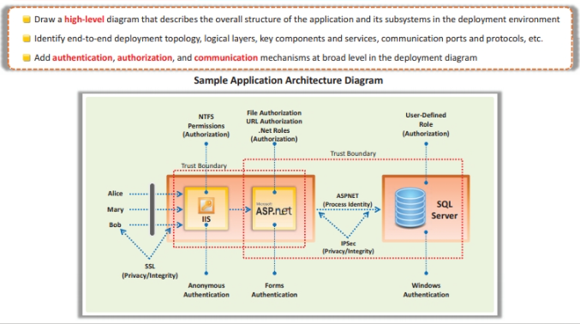

Slide 15
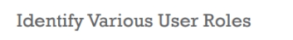
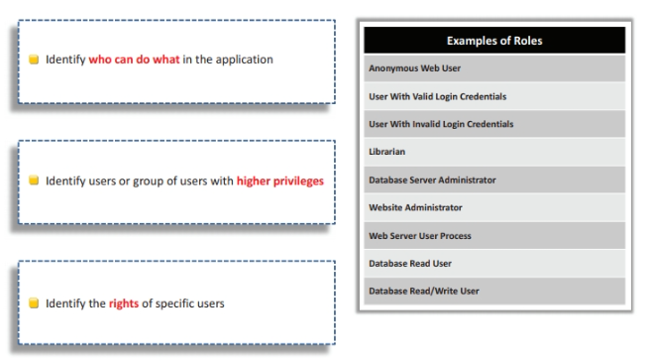

Slide 16
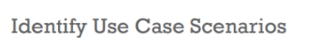
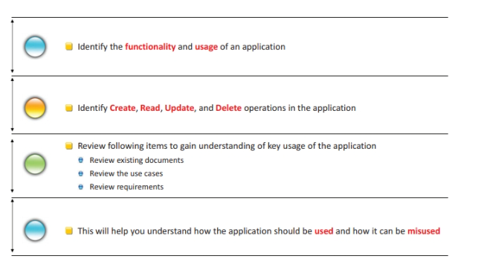

Slide 17
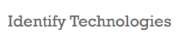
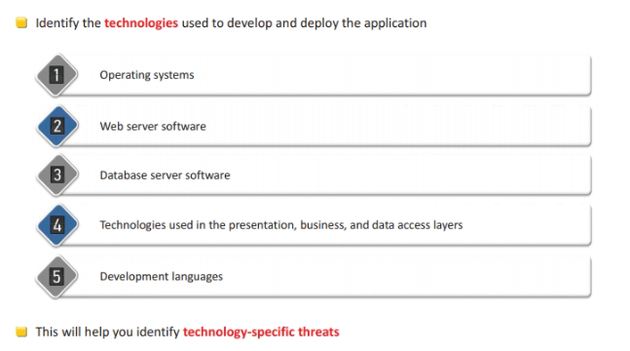

Slide 18
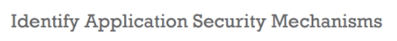
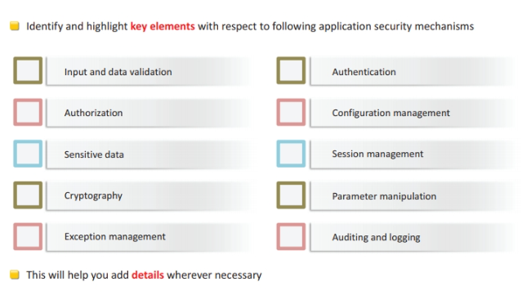

Slide 19
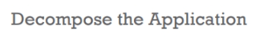
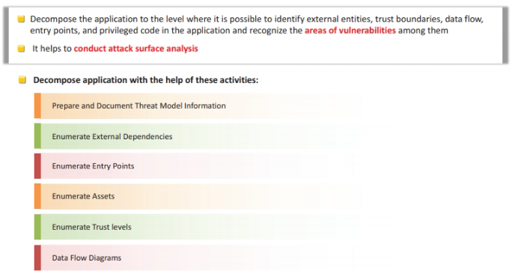

Slide 20
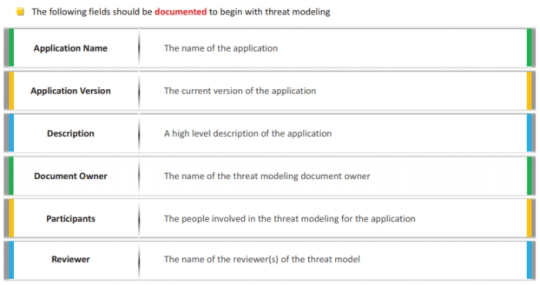

Slide 21
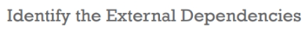
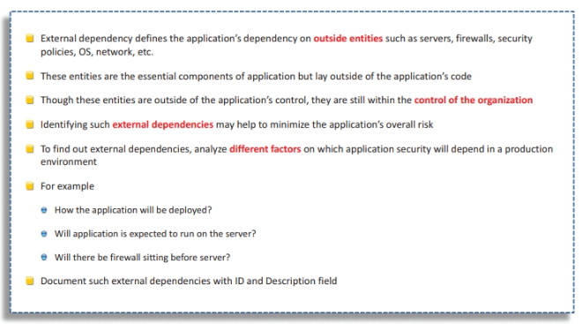

Slide 22
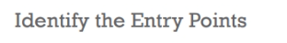
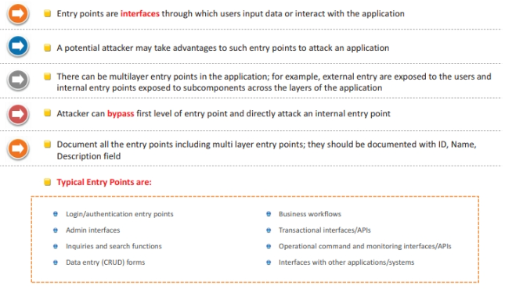

Slide 23
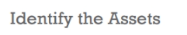
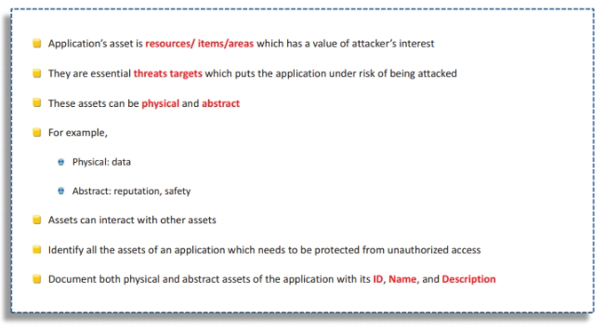

Slide 24
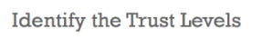
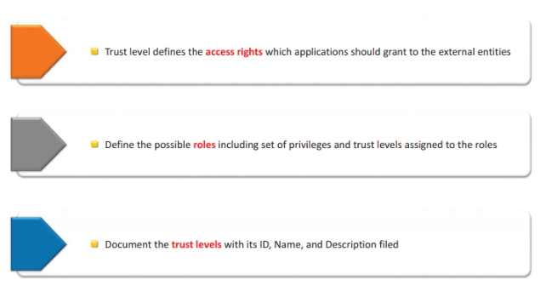

Slide 25
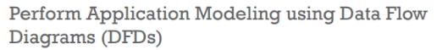
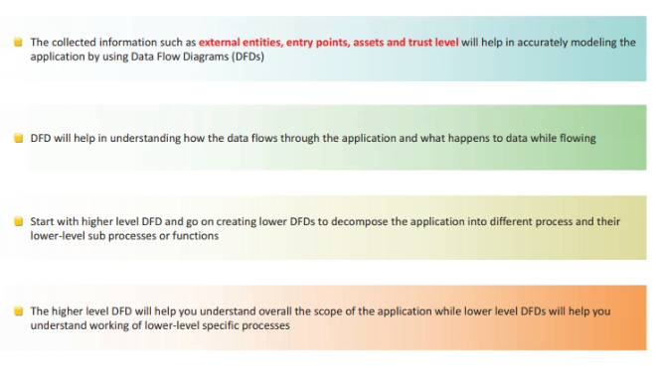

Slide 26
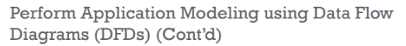
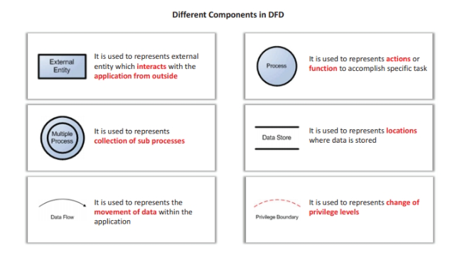

Slide 27
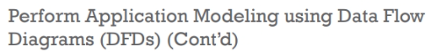
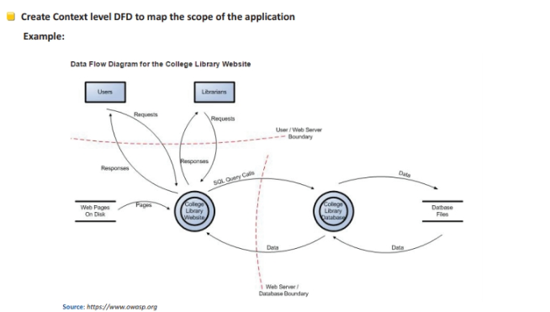

Slide 28
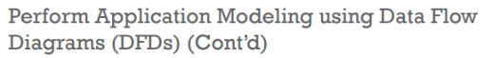
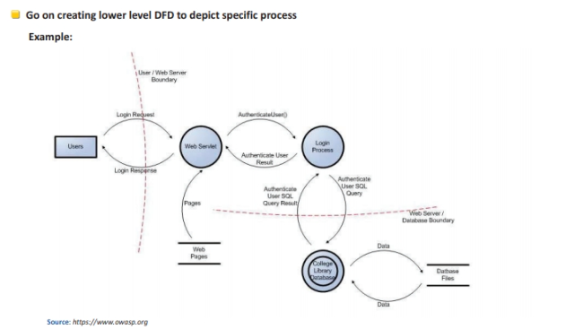

Slide 29
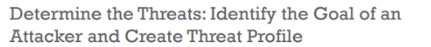


Slide 30



Slide 31


Slide 32



Slide 33



Slide 34



Slide 35


Slide 36



Slide 37



Slide 38



Slide 39



Slide 40



Slide 41



Slide 42



Slide 43
Secure Code Programming – CERT and SANS 25
CERT (Computer Emergency Response Team) and SANS (SysAdmin, Audit, Network, and Security) are organizations that maintain lists of secure coding practices.

Slide 44
Secure Code Programming – CERT and SANS 25 (Cont.,)
CERT Secure Coding Standards: A set of best practices designed to help programmers avoid common programming errors leading to security vulnerabilities.
Examples include avoiding buffer overflows and proper memory management.

Slide 45
Secure Code Programming – CERT and SANS 25 (Cont.,)
SANS Top 25: A list of the 25 most dangerous programming errors that expose applications to attack.
These include improper validation of input, lack of encryption, and poor session management.

Slide 46
Securing Artifacts Deployed on Target Machines
Once software is deployed, it’s important to secure the deployed artifacts. Strategies include:
Code Obfuscation: Making the code difficult to reverse-engineer by using obfuscation techniques.
Encryption: Encrypting sensitive data, both at rest and in transit.

Slide 47
Securing Artifacts Deployed on Target Machines (Cont.,)
File Integrity Checks: Using tools to monitor changes to key files and binaries.
Least Privilege: Ensure deployed artifacts have the minimum permissions necessary.

Slide 48
Protection of Devices Against Vulnerabilities Over Ethernet
Ethernet-based devices are vulnerable to attacks such as man-in-the-middle (MITM) or eavesdropping. Protecting these devices includes:
Encryption: Secure communication over Ethernet using protocols like TLS or IPsec.
Network Segmentation: Isolating critical systems from less-secure networks.

Slide 49
Protection of Devices Against Vulnerabilities Over Ethernet (Cont.,)
Firewalls: Implementing firewalls to filter malicious traffic.
Regular Patching: Ensuring firmware and software are up to date with the latest security patches.

Slide 50
Common vulnerabilities in C# code
1. SQL Injection
It occurs when user input is directly concatenated into SQL queries.
Cause: Using string concatenation instead of parameterized queries.
// Vulnerablestring query = "SELECT * FROM Users WHERE Username = '" + userInput + “’”;
Fix: Use parameterized queries with SqlCommand or ORM frameworks.---

Slide 51
ORM
ORM (Object-Relational Mapping)
ORM framework is a tool or library that helps developers interact with relational databases (like MySQL, PostgreSQL, SQL Server, Oracle, etc.) using an object-oriented approach instead of writing raw SQL queries.
It maps database tables to classes, rows to objects, and columns to attributes.

Slide 52
Common vulnerabilities in C# code (Contd.,)
2. Cross-Site Scripting (XSS)
Happens in web apps (ASP.NET) when user input is displayed without sanitization.
Cause: Rendering untrusted data directly in web pages.
//VulnerableResponse.Write(Request.QueryString["name"]);
Fix: Encode output using HttpUtility.HtmlEncode().

Slide 53
Common vulnerabilities in C# code (Contd.,)
3. Insecure Deserialization
Malicious data is deserialized, leading to code execution or data tampering.
Cause: Using BinaryFormatter or similar without validation.
Fix: Avoid BinaryFormatter and use safe serializers like System.Text.Json.---

Slide 54
Common vulnerabilities in C# code (Contd.,)
4. Hardcoded Credentials / Secrets
Storing API keys, passwords, or connection strings in code.string password = "Admin@123";
Fix: Use environment variables or Azure Key Vault.---

Slide 55
Common vulnerabilities in C# code (Contd.,)
5. Improper Error Handling (Information Disclosure)
Exposing stack traces, database names, or server details in error messages.
Fix: Use custom error pages and centralized exception handling.---

Slide 56
Common vulnerabilities in C# code (Contd.,)
6. Cross-Site Request Forgery (CSRF)
Exploits authenticated users to perform unwanted actions.
Fix: Use ASP.NET’s built-in [ValidateAntiForgeryToken].

Slide 57
Common vulnerabilities in C# code (Contd.,)
7. Insecure File Upload
Allowing any file type to be uploaded without validation.
Fix: Validate file type, size, and scan files before processing.

Slide 58
Common vulnerabilities in C# code (Contd.,)
8. Unvalidated Redirects and Forwards
Redirecting users based on untrusted input.Response.Redirect(Request.QueryString["url"]);
Fix: Whitelist allowed URLs.

Slide 59
Common vulnerabilities in C# code (Contd.,)
9. Weak Cryptography
Using outdated algorithms like MD5, SHA1, or DES.
Fix: Use modern algorithms (e.g., AES-256, SHA-256, PBKDF2).

Slide 60
Coding
10. Insufficient Input Validation
Accepting user input without checking type, length, or format.Leads to buffer overflows, logic errors,

Slide 61
OWASP Top 10
Secure C# Coding Checklist (Top 10 Practices)
1. Use Parameterized Queries/ORM – Prevent SQL injection with SqlParameter or Entity Framework.
2. Validate & Sanitize Input – Use Regex, int.TryParse(), or DataAnnotations.
3. Output Encoding for Web Apps – Use HttpUtility.HtmlEncode() or Razor’s @Html.Encode.
4. Avoid Hardcoded Secrets – Store in Azure Key Vault, AWS Secrets Manager, or environment variables.

Slide 62
OWASP Top 10
5. Use Strong Cryptography – AES-256, SHA-256, PBKDF2 for passwords (Rfc2898DeriveBytes).
6. Implement Proper Error Handling – Custom error pages, no stack traces in production.
7. Apply Principle of Least Privilege – Minimize database and service account permissions.
8. Secure File Uploads – Check MIME type, extension, and scan for malware.
9. Enable HTTPS & HSTS – Always encrypt data in transit.
10. Keep .NET & Libraries Updated – Regularly patch and update NuGet dependencies.

Slide 63
OWASP Top 10
Real-World Vulnerable C# Code & Fixes
SQL Injection
❌ Vulnerablestring query = "SELECT * FROM Users WHERE Username = '" + username + "'";
SqlCommand cmd = new SqlCommand(query, conn);
✅ Fixed
string query = "SELECT * FROM Users WHERE Username = @username";
SqlCommand cmd = new SqlCommand(query, conn);
cmd.Parameters.AddWithValue("@username", username);

Slide 64
OWASP Top 10
Real-World Vulnerable C# Code & Fixes
XSS (Cross-Site Scripting)
❌ Vulnerable
Response.Write(Request.QueryString["name"]);
✅Fixed
Response.Write(HttpUtility.HtmlEncode(Request.QueryString["name"]));---

Slide 65
OWASP Top 10
Real-World Vulnerable C# Code & Fixes
Hardcoded Password
❌ Vulnerable
string dbPassword = "Admin@123";
✅ Fixed
string dbPassword = Environment.GetEnvironmentVariable("DB_PASSWORD");

Slide 66
OWASP Top 10
Real-World Vulnerable C# Code & Fixes
Insecure Deserialization
❌ Vulnerable
BinaryFormatter formatter = new BinaryFormatter();
object obj = formatter.Deserialize(stream);
✅ Fixed
Avoid BinaryFormatter; use safe serializers like System.Text.Json
var myObject = JsonSerializer.Deserialize<MyClass>(jsonString);

Slide 67
OWASP Top 10 for C#/.NET
1. Injection (SQL, LDAP, XML)
Risk: Data manipulation, credential theft
Mitigation: Use parameterized queries
2. Broken Authentication
Risk: Session hijacking
Mitigation: Use ASP.NET Identity or OAuth

Slide 68
OWASP Top 10 for C#/.NET
3. Sensitive Data Exposure
Risk: Leaking passwords, PII
Mitigation: Encryption at rest & transit
4. XML External Entities (XXE)
Risk: File disclosure via XML parsers
Mitigation: Disable DTD processing in XmlReaderSettings

Slide 69
OWASP Top 10 for C#/.NET
5. Broken Access Control
Risk: Unauthorized data access
Mitigation: Implement role-based access control (RBAC)
6. Security Misconfiguration
Risk: Debug info, open ports, weak headers
Mitigation: Enforce CSP, disable debug mode in production

Slide 70
OWASP Top 10 for C#/.NET
7. Cross-Site Scripting (XSS)
Risk: Script injection
Mitigation: Encode all outputs
8. Insecure Deserialization
Risk: Remote code execution
Mitigation: Use safe serializers

Slide 71
OWASP Top 10 for C#/.NET
9. Using Components with Known Vulnerabilities
Risk: Exploits via old NuGet packages
Mitigation: Regularly update packages
10. Insufficient Logging & Monitoring
Risk: Missed attacks, no audit trail
Mitigation: Use centralized logging (e.g., Serilog, ELK stack)

Slide 72



Slide 73



Slide 74



Slide 75



Slide 76



Slide 77



Slide 78



Slide 79



Slide 80



Slide 81



Slide 82



Slide 83



Slide 84



Slide 85


Slide 86



Slide 87



Slide 88



Slide 89



Slide 90
Security Testing with SAST, DAST Tools and Fuzz Testing (Cont.,)
Fuzz Testing: Involves sending random, invalid, or unexpected data to the application to identify security weaknesses or crashes.
Fuzz Testing can be applied to both Windows and Linux environments to check for vulnerabilities in user inputs, network protocols, or system interactions.

Slide 91
Plugins for Debugging C++ Files in IDE
Popular IDEs for C++ development, such as Visual Studio and CLion, support various debugging plugins that assist in finding and fixing security vulnerabilities:
Visual Studio: Tools like Static Code Analysis, Visual Studio Debugger, and ReSharper C++ provide insights into code quality and security.

Slide 92
Plugins for Debugging C++ Files in IDE (Cont.,)
CLion: Integrated with GDB or LLDB for powerful debugging. It also supports static analysis tools like Cppcheck and Clang-Tidy.
Eclipse CDT: Offers plugins like Valgrind and gdb for memory error detection and debugging.

Slide 93
Summary
In this session we discussed about the overview of secure software development covers cyber attacks, SSDLC, Secure Design, and architecture phases.
Also we discussed about the threat modeling and the multiple tired security include proper input validation, data encryption etc.,
We concluded with the secure design principles with their guidelines which should be enforced on the devlopers

